Slide 1
Data Acquisition
Musadaq Mansoor

Slide 2
Scraping
To analyze data, we typically need structure. For instance, same number of rows for each column.
But found data often with human readable structure.
Idea: Find the less accessible structure, automate based on it.

Slide 3

Collecting found digital data
Software
R - Not the best but will do.
Python, Ruby, Perl, Java, . . .
80 Legs, Grepsr . . .
Some things to keep in mind
Check if there is an API, or if data are available for download
Play Nice:
Scraper may be disallowed in `robots.txt‘
Scrape during off-peak hours

Slide 4

Paper

Slide 5
Paper
Create digital images of paper
Identify colored pixels as characters (OCR)
Software
Adobe Pro., etc.
Best in class commercial: Abbyy FineReader
Now has an API
Best in class open-source: Tesseract
Scrape off recognized characters: pyPdf etc
Post-processing

Slide 6
Web Scrapping

Slide 7
Components of Web Scrapping
Crawl: The first step is to navigate to target website by making an HTTP request and download the response you get
Parse and Transform: When you have the response, you can use HTML parser like Beautiful Soup and extract the required data
Store: When you have the required data, you can store this into csv or database

Slide 8
Beautiful Soup / PyPdf2
Musadaq Mansoor

Slide 9
Introduction
Beautiful Soup is a Python library for pulling data out of HTML and XML files. It works with your favorite parser to provide idiomatic ways of navigating, searching, and modifying the parse tree. It commonly saves programmers hours or days of work.
The current release is Beautiful Soup 4.9.3 (October 3, 2020). You can install Beautiful Soup 4 with pip install beautifulsoup4.

Slide 10
HTML
html_doc = """<html><head><title>The Dormouse's story</title></head>
<body>
<p class="title"><b>The Dormouse's story</b></p>
<p class="story">Once upon a time there were three little sisters; and their names were
<a href="http://example.com/elsie" class="sister" id="link1">Elsie</a>,
<a href="http://example.com/lacie" class="sister" id="link2">Lacie</a> and
<a href="http://example.com/tillie" class="sister" id="link3">Tillie</a>;
and they lived at the bottom of a well.</p>
<p class="story">...</p>
"""

Slide 11
Load HTML in Python
from bs4 import BeautifulSoup
soup = BeautifulSoup(html_doc, 'html.parser')

Slide 12
Navigating the document
soup.title
# <title>The Dormouse's story</title>
soup.title.name
# 'title'
soup.title.string
# 'The Dormouse's story'
soup.title.parent.name
# 'head'

Slide 13
Navigating the document
soup.p
# <p class="title"><b>The Dormouse's story</b></p>
soup.p['class']
# 'title'
soup.a
# <a class="sister" href="http://example.com/elsie" id="link1">Elsie</a>
soup.find_all('a')
# [<a class="sister" href="http://example.com/elsie" id="link1">Elsie</a>,
# <a class="sister" href="http://example.com/lacie" id="link2">Lacie</a>,
# <a class="sister" href="http://example.com/tillie" id="link3">Tillie</a>]

Slide 14
Navigating the document
soup.find(id="link3")
# <a class="sister" href=http://example.com/tillie id="link3">Tillie
</a>

Slide 15
Printing all the links
for link in soup.find_all('a'):
print(link.get('href'))
# http://example.com/elsie
# http://example.com/lacie
# http://example.com/tillie

Slide 16
Printing all the text
print(soup.get_text())
The Dormouse's story
The Dormouse's story
Once upon a time there were three little sisters; and their names were
Elsie,
Lacie and
Tillie;
and they lived at the bottom of a well.

Slide 17
Scrapping Website
Shakespeare's Twelfth Night
Using Beautiful Soup
from bs4 import BeautifulSoup
import urllib.request
from urllib.request import urlopen
url = urlopen('http://shakespeare.mit.edu/twelfth_night/full.html').read()
soup = BeautifulSoup(url, 'html.parser')

Slide 18
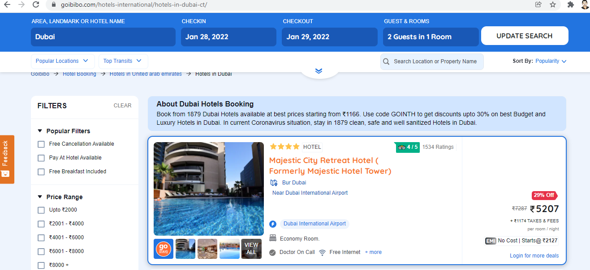
Example
Scrapping hotel details like the name of the hotel and price per room from the goibibo website:

Slide 19
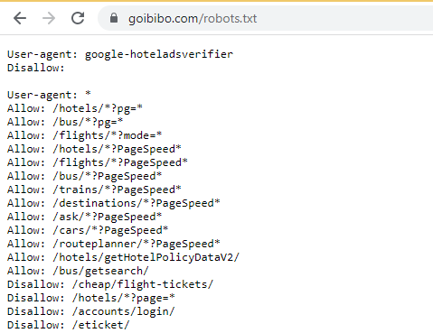
Check robots.txt

Slide 20
Crawl
The first step in web scraping is to navigate to the target website and download the source code of the web page.
We are going to use the requests library to do this.
A couple of other libraries to make requests and download the source code.

Slide 21
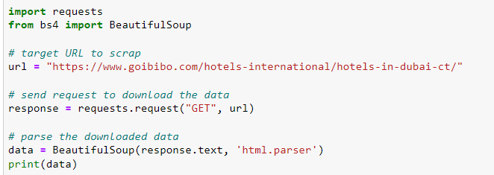
Crawl

Slide 22
Parse and Transform
The next step in web scraping is to parse this data into an HTML Parser and for that, we will use the BeautifulSoup library. Now, if you have noticed our target web page, the details of a particular hotel are on a different card like most web pages.
So, the next step would be to filter this card data from the complete source code. Next, we will select the card and click on the ‘Inspect Element option to get the source code of that particular card. You will get something like this:

Slide 23
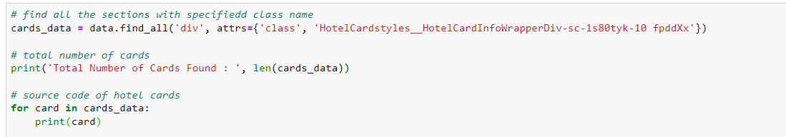
Parse and Transform - I

Slide 24
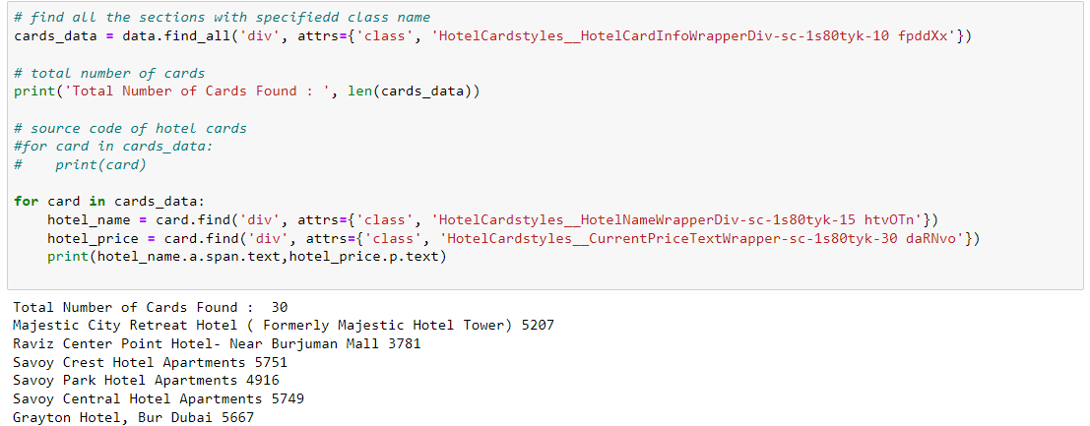
Parse and Transform - II

Slide 25
Store
The final step is to store the extracted data in the CSV file. Here, for each card, we will extract the Hotel Name and Price and store them in a Python dictionary. We will then finally append it to a list.
Next, let’s go ahead and transform this list to a Pandas data frame as it allows us to convert the data frame into CSV or JSON files:

Slide 26
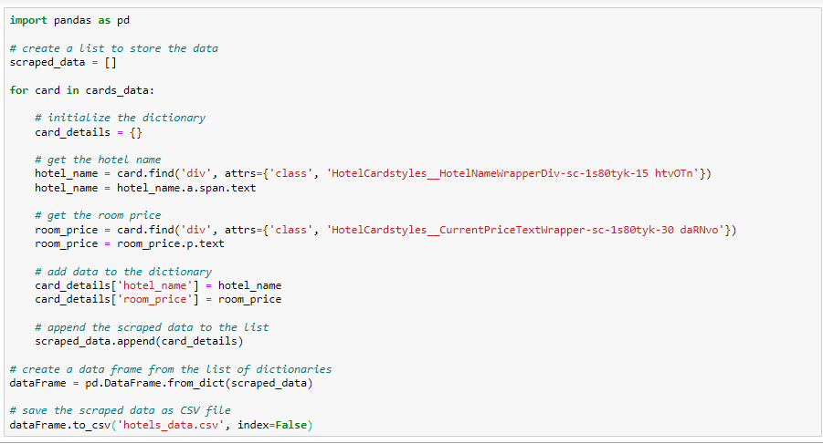
Store

Slide 27

Note This requires responsibility/permission, don’t start scrapping every website.

